Slide 1

Visualizing 1 billion stars

Slide 2
Approach
Analyze Big Picture
Scatterplotmatrix
Correlations
Pattern recognition

Slide 3
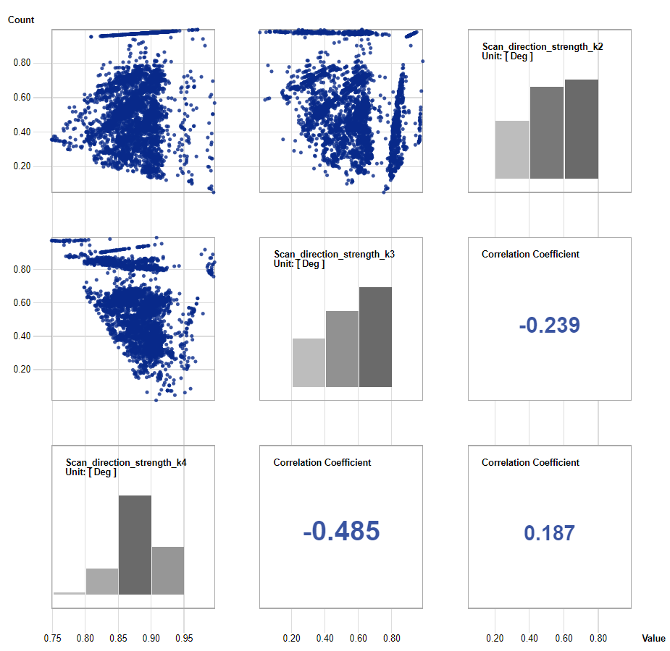
Overview
Scatterplot
Correlations
Distribution
PCA

Slide 4
PCA
Prefiltering
Reduce dimension of dataset
Dimstiller

Slide 5
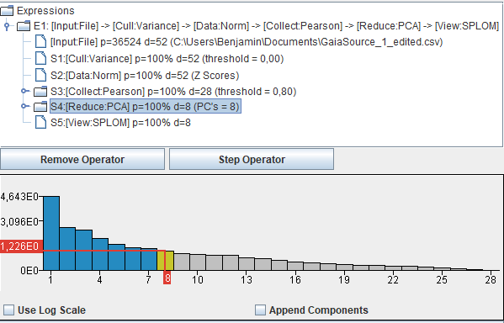
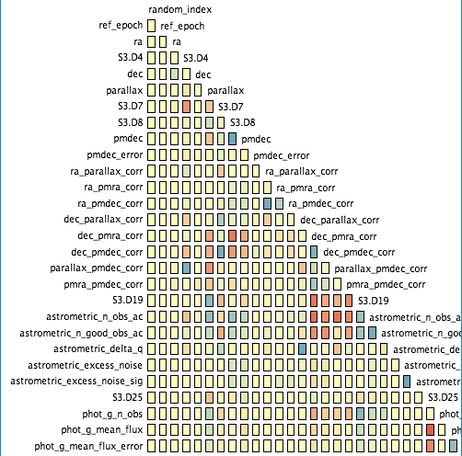
PCA
Dimstiller

Slide 6
Live Presentation
http://wwwlab.cs.univie.ac.at/~a1368965/impl/index.html

Slide 7
Challenges and Problems
Dataset
Filter
Plots
Javascript / D3
Performance
Notes:
Dataset: Satelite collects data Filter: Filter and refilter
Plots: too many data, hard to visualize to find patterns, outliers, …
Javascript/D3: offers many ways to present data but limitations, like A3, long loading times for plotting, issuer: gain performance
7

Slide 8
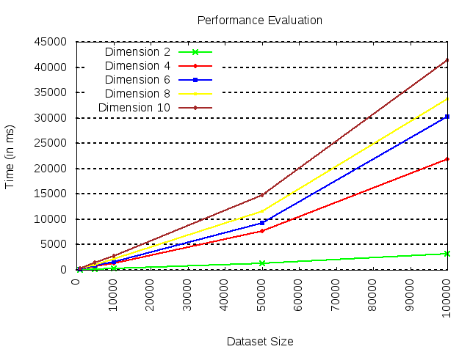
Notes:
Dataset: Satelite collects data Filter: Filter and refilter
Plots: too many data, hard to visualize to find patterns, outliers, …
Javascript/D3: offers many ways to present data but limitations, like A3, long loading times for plotting, issuer: gain performance
8

Slide 9
Optimization
3D Plot
Performance
PCA Implementation
Notes:
Dataset: Satelite collects data Filter: Filter and refilter
Plots: too many data, hard to visualize to find patterns, outliers, …
Javascript/D3: offers many ways to present data but limitations, like A3, long loading times for plotting, issuer: gain performance
9

Slide 10
Thank you for your attention

